Slide 1

FPGA Design for Embedded Systems
Hardware Description Languages for Logic Design

Slide 2

An Introduction to Verilog
Verilog is one of the most powerful and efficient languages for logic design.
Now that the basics have been introduced, in this Module we will further explore how to use Verilog to design circuits by looking at many examples and techniques.

Slide 3
Learning to Speak Verilog
Like any other language…
Learn key phrases, practice them
begun
Learn Grammar and Syntax
done
Make compound sentences
Practice, Practice, Practice

Slide 4
Writing Verilog for
A 4-bit Register
D3
D2
D1
D0
D
Q
D
Q
D
Q
D
Q
En
En
En
En
R
R
R
R
Clk
Load
Reset

Slide 5
Writing Verilog for A 4-bit Register
// Data Register
//
module Dreg (
input wire [3:0] d,
input wire clk, reset, load,
output reg [3:0] q
);
always @(posedge clk or negedge reset)
begin
if (!reset) // asynchronous reset
q <= 0;
else if (load == 1)
q <= d;
end
endmodule

Slide 6
Videos in this Module
Learning to Speak Verilog
Combinatorial Circuits
Synchronous Logic: Latches and Flip Flops
Synchronous Logic: Counters and Registers
Interface: Buses and Tri-state Buffers
Modular Design in Verilog
Test Benches in Verilog - Combinatorial
Test Benches in Verilog – Synchronous
Memories of Verilog
Finite State Machines in Verilog

Slide 7
Combinatorial Circuits in Verilog
In this video, you will learn:
How to describe combinatorial circuits in Verilog
How to reduce vector sizes using reduction operators

Slide 8
Basic Gates Assigned in Verilog
A
W
A
B
B
A
Z
U
C
B
D
C
X
D
C
Y
D
vA[0]
vA[0]
vY[0]
vX[0]
vB[0]
vB[0]
vA[1]
vA[1]
vX[1]
vB[1]
vY[1]
vB[1]
vA[2]
vA[2]
vX[2]
vB[2]
vY[2]
vB[2]
vA[3]
vA[3]
vY[3]
vB[3]
vX[3]
vB[3]

Slide 9
Basic Gates Assigned in Verilog
module gates ( // module and name
input A, B, C, D,
input [3:0] vA, vB,
output W, U, X, Y, Z,
output [3:0] vX, vY);
assign W = A & B; // scalar AND Gate
assign U = ~(A | B); // scalar NOR Gate
assign X = C ^ D; //scalar XOR Gate
assign Y = C ~^ D; //scalar XNOR Gate
assign Z = (A & B) | (C & D); // AND-OR gates
assign vX = vA & vB; // Vector bitwise AND
assign vY = vA | vB; // Vector bitwise OR
endmodule

Slide 10
Vector Reduction in Verilog
module gates ( // module and name
input [3:0] vA, vB, vC, vD,
output W, U, X, Y, Z);
assign W = & vA; // Vector Reduction AND Gate
assign U = ~| vB; // Vector reduction NOR Gate
assign X = ^ vD; // Vector reduction XOR Gate
assign Y = | vA & vB ; // bitwise or reduction?
assign Z = | (vA & vB); // bitwise AND,
// reduction OR
endmodule

Slide 11
Vector Reduction Gates in Verilog
vA[0]
vA[0]
vA[1]
W
vA[1]
vA[2]
vA[2]
Y
vA[3]
vA[3]
vB[0]
vB[0]
vB[1]
U
vB[2]
vB[3]
vD[0]
vD[1]
X
vD[2]
vD[3]
vA[0]
vB[0]
vA[1]
Z
vB[1]
vA[2]
vB[2]
vA[3]
vB[3]

Slide 12
Procedural Combinational Logic with Always Procedures
module always_combo (
input A, B, C, D,
output reg Y);
always @(A or B or C or D)
begin
if ((C==1) && (D==1))
Y <= 0;
else if ((A==1) || (B==1))
Y <= 1;
else
Y <= 0;
end
endmodule

Slide 13
Procedural Combinational Logic with Always Procedures - Result
A
B
Y
C
D

Slide 14
Procedural Combinational Logic with Always Procedures – Gotcha!
module always_combo (
input A, B, C, D,
output reg Y);
always @(A or B or C or D)
begin
if ((C==1) && (D==1))
Y <= 0;
else if ((A==1) || (B==1))
Y <= 1;
end
endmodule

Slide 15
Procedural Combinational Logic with Incomplete Assignment - Result
‘1’
A
B
Latch
D
C Q
R
Y
C
D

Slide 16
Summary – Verilog for Combinatorial Circuits
In this video, you have learned:
How to describe combinatorial circuits in Verilog using either assignment statements or always procedures
How to reduce vector sizes using reduction operators
How to prevent unintentional latches in our logic circuits

Slide 17
References
[1] V. Angelov. (2009). Introduction to Verilog. [Online]. Available: https://www.physi.uni-heidelberg.de/~angelov/VHDL/VHDL_SS09_Teil10.pdf

Slide 18
Synchronous Circuits in Verilog
// D flip flop
//
module DFF (
input D, Ck,
output reg Q
);
always @(posedge Ck)
Q <= D;
endmodule

Slide 19
Synchronous Logic: D Latch
How can we make D Latches in Verilog?
D
Q
C
R

Slide 20
Synchronous Logic: D Latch
// D latches
//
module DLatches ( d, clk, aclr, qldc, qld);
input d, clk, aclr;
output reg qldc, qld;
always @(clk or d) // no posedge!
begin
if (clk == 1) qld <= d;
end
always @(clk or d or aclr)
// note d is on the sensitivity list
begin
if (aclr == 1) qldc <= 0;
else if (clk == 1) qldc <= d;
end
endmodule

Slide 21
Synchronous Logic: D Flip Flops
How can we make D Flip-flops in Verilog, including those with asynchronous or synchronous reset?
S
D
Q
R

Slide 22
Synchronous Logic: D Flip Flops
// D Flip Flops
//
module DFF (d, clk, clr, reset, qld, qlda, qlds);
input d, clk, clr, reset;
output reg qld, qlda, qlds;
always @(posedge clk) // with posedge!
begin
qld <= d; //standard FF
if (reset == 0) qlds <= 0;
else qlds <= d; // FF with sync reset
end
always @(posedge clk or negedge clr)
begin
if (clr == 0) qlda <= 0;
else qlda <= d; // FF with async reset
end
endmodule

Slide 23
Synchronous Logic: D Flip Flops
How can we make Clock Enable in Verilog?
S
D
Q
En
R

Slide 24
Synchronous Logic: D Flip Flops
// D Flip Flops with clock enable
//
module DFFe (d, clk, ce, clr, reset, qlda, qlds);
input d, clk, ce, clr, reset;
output reg qld, qlda, qlds;
always @(posedge clk) //
begin // FF with sync reset & clk enable
if (reset == 1) qlds <= 0;
else if (ce == 1) qlds <= d;
end
always @(posedge clk or posedge clr)
begin // FF with async reset & clk enable
if (clr == 1) qlda <= 0;
else if (ce == 1) qlda <= d;
end
endmodule

Slide 25
Summary – Verilog for Combinatorial Circuits
In this video, you have learned:
How to describe synchronous circuits in Verilog
How to design flip-flops and latches in Verilog

Slide 26
References
[1] V. Angelov. (2009). Introduction to Verilog. [Online]. Available: https://vdocuments.mx/amp/introduction-to-verilog-physikalisches-institut-angelovvhdlvhdlss09teil10pdf.html

Slide 27
Synchronous Logic: Register
Data is oftentimes stored in a register for later use. How can we make a data register in Verilog?
D3
D2
D1
D0
D
Q
D
Q
D
Q
D
Q
En
En
En
En
R
R
R
R
Clk
Load
Reset
Q3
Q2
Q1
Q0

Slide 28
Synchronous Logic: Data Register
// Data Register
//
module Dreg (
input wire [3:0] d,
input wire clk, reset, load,
output reg [3:0] q
);
always @(posedge clk or negedge reset)
begin
if (!reset) // asynchronous reset
q <= 0;
else if (load == 1)
q <= d;
end
endmodule

Slide 29
Synchronous Logic: Shift Register
How can we make a shift register in Verilog?
D0
D
Q
D
Q
D
Q
D
Q
En
En
En
En
R
R
R
R
Clk
Shift
Reset
Q0
Q1
Q2
Q3

Slide 30
Synchronous Logic: Shift Register
// Shift Register
//
module Shifter (clk, reset, D0, shift, Q);
input clk, reset, D0, shift;
output reg [3:0] Q;
always @(posedge clk) //
begin
if (!reset)
Q <= 4’b0000;
else if (shift == 1)
begin
Q <= Q << 1;
Q[0] <= D0;
end
else ;
end
endmodule

Slide 31
Synchronous Logic: Binary Counter
How can we make a binary counter in Verilog?
Data (D3..D0)
Reset
Load
En
Counter
Clock
Q (D3..D0)

Slide 32
Synchronous Logic: Binary Counter
// Binary Counter
//
module Counter (
input wire [3:0] d,
input wire clk, reset, load, en,
output reg [3:0] q
);
always @(posedge clk)
begin
if (reset) // synchronous reset
q <= 0;
else if (load == 1’b1)
q <= d;
else if (en == 1’b1)
q <= q + 1;
end
endmodule

Slide 33
Synchronous Logic: Register File
Register Files are useful constructs that allow addressing of registers. Here we assume each flip flop represents an n-bit register.
wdata
D
Q
En
D
Q
rdata
wAddress
En
Decoder
D
Q
wren
En
Clk
D
Q
En
rAddress

Slide 34
Synchronous Logic:
Register File
// Data Register File
// 4 x 8
module regFile #(
parameter Dwidth = 8, // #bits in word
Awidth = 2 // #address bits
)
(
input wire clk, wren,
input wire [(Dwidth1):0] wdata,
input wire [(Awidth1):0] waddr, raddr,
output wire [(Dwidth-1):0] rdata
);
// Signal Declaration
reg [Dwidth-1:0] array_reg [2**Awidth-1:0];
always @(posedge clk)
if (wren) // synchronous enable
array_reg[waddr] <= wdata;
assign rdata = array_reg[raddr];
endmodule

Slide 35
Tri-state Buses
External connections on FPGA pins are often in a group of related signals known as a bus.
The I/O structures of FGPAs often allow the bus to be tri-stated, so that multiple drivers can be attached to the bus at the same time, with only one active.
Dout[n]
FPGA Pin
OE

Slide 36
Tri-state Buses in Verilog
// Tri-state bus
//
module Tri (
input wire [3:0] Dout,
input wire OE,
output wire [3:0] Pinout
);
assign Pinout = OE ? Dout : 4'bz;
endmodule

Slide 37
Tri-state Buses in Verilog for Simulation
// Tri-state bus
//
module Tri (
input wire [3:0] Dout,
input wire OE,
output wire [3:0] Pinout
);
assign Pinout = (OE == 1) ? Dout :
(OE == 0) ? 4'bz : 4'bx;
endmodule

Slide 38
Tri-state Buses
When driving external tri-stated buses, some protocol should be used to assure that only one drive is active on the bus at a time.
Internal Tri-state buses can be defined, but typically are not implemented by FPGA tools as enabled buffers but rather as multiplexers.
Bus0[n]
Bus1[n]
OE

Slide 39
Bi-directional Buses
The I/O structure of the FPGA will also allow us to create Bi-directional buses, in which the external pin can be treated as either an input or an output, depending on the state of the enable signal.
Din[n]
Dout[n]
FPGA Pin
OE

Slide 40
Bi-directional Buses in Verilog
// Bi-directional bus
//
module BiDir (
output wire [3:0] Din,
input wire [3:0] Dout,
input wire OE,
inout wire [3:0] IOpin
);
assign Din = IOpin;
assign IOpin = (OE == 1) ? Dout :
(OE == 0) ? 4'bz : 4'bx;
endmodule

Slide 41
Joining and Splitting Buses
Verilog includes the concatenation and replication operators which allows buses to be combined. Splitting buses can be done using indexing.
A[0]
Dout[0]
A[1]
Dout[1]
A[2]
Dout[2]
B[0]
Dout[3]
B[1]
Dout[4]
B[2]
Dout[5]
A[3]
X
A[4]
Y

Slide 42
Joining and Splitting Buses
// Manipulating Buses
//
module BusMe (
input wire [4:0] A,
input wire [2:0] B,
output wire X,Y,
output wire [5:0] Dout
);
assign Dout = {B,A[2:0]};
assign X = A[3];
assign Y = A[4];
endmodule

Slide 43
Modular Design in Verilog
Given the principal design entity in Verilog is a module, one could infer that Verilog designs should be modular. Many tools are provided in Verilog to make this happen, including
Component Instantiation
Looping
Generate Blocks
Tasks and Functions

Slide 44
Component Instantiation in Verilog
A modular design in Verilog at the top level oftentimes consists only of component instantiations, the fundamental way to build hierarchy in a design.
module module_name_top (port connection list) instance_name_1 (port connection list), instance_name_2 (port connection list),
....... instance_name_n (port connection list);
endmodule

Slide 45
Component Instantiation in Verilog
// 16-bit Adder
// built with 4 instantiations of
// 4-bit Adders
module Add16_top (
input [15:0] A,
input [15:0] B,
input Cin,
output Cout,
output [15:0] Sum
);
wire Cin2, Cin3, Cin4; //intermediate Cin
add4 add4_1 (.Data1(A[3:0]), .Data2(B[3:0]), .Cin(Cin), .Cout(Cin2), .Sum(Sum[3:0]));
add4 add4_2 (.Data1(A[7:4]), .Data2(B[7:4]), .Cin(Cin2), .Cout(Cin3), .Sum(Sum[7:4]));
add4 add4_3 (.Data1(A[11:8]), .Data2(B[11:8]), .Cin(Cin3), .Cout(Cin4), .Sum(Sum[11:8]));
add4 add4_4 (.Data1(A[15:12]), .Data2(B[15:12]), .Cin(Cin4), .Cout(Cout), .Sum(Sum[15:12]));
endmodule

Slide 46
Looping in Verilog
There are several looping constructs within Verilog, including
repeat
while
forever
for
The for loop statement is written and behaves just like it does in C, as is the while loop.
The forever loop is explicitly an infinite loop.
The repeat statement executes a statement or block of statements a fixed number of times.

Slide 47
Looping in Verilog Example
// And scalar g with vector A
//
Module scalarAnd
#(parameter N = 4);
(input g,
input [N-1:0] a,
output [N-1:0] y);
reg [N-1:0] tmp, y;
integer i; //loop index, not signal
always @(a or g)
begin
for(i=0; i<N; i=i+1)
begin
tmp[i] = a[i] & g;
end
y = tmp;
end
endmodule

Slide 48
Generate in Verilog
Although loops can be used to generate data or test patterns, in Verilog a common use of loops for synthesis is replication of many identical circuits within generate blocks.
The generate … end generate block specifies how an object is to be repeated. Variables used to specify the repetition are called genvars. The index variable of a for loop in a generate block must be a genvar.

Slide 49
Generate in Verilog Example
// Generate n XOR gates
//
module XorGen
#(parameter width = 4,
delay = 10)
(output [1:width] xout,
input [1:width] xin1, xin2
);
generate
genvar i;
for (i=1; i<=width; i=i+1)
begin
assign #delay
xout[i] = xin1[i] ^ xin2[i];
end
endgenerate
endmodule

Slide 50
What is a testbench?
A testbench is a program written in any language for the purposes of exercising and verifying the functional correctness of the hardware model as coded.
Also known as a test fixture or test harness.
A powerful tool for auto-generating test stimulus and test results

Slide 51
Testbenches Functional Sections
A testbench can have several functional sections, including:
Top-level testbench declaration
Stimulus and Response Signal declarations
Component declarations
Component (Device Under Test) instantiations
External Stimulation Device Models
Test Process which applies the stimulus to the DUT
Test Monitor which reports results

Slide 52
Testbench Structure
HDL Test Harness
Model Under Test
External Stimulus Generator Models
Output Vectors
Compare Results (Test Monitor)
ResultsFile
Test Stimulus (Waveform Generation)
Stimulus
Vectors
Test Vectors File
Reference Vectors
Display Pass/Fail

Slide 53
Adder Test Bench
`timescale 1 ns / 1 ps // set timescale to
//nanoseconds, ps precision
module Adder_tb(); // no sensitivity list!
// signal declarations
reg [3:0] a_tb, b_tb; // data input stimulus
reg Cin; // data input stimulus
wire [3:0] y_tb; // data output response
wire Co_tb; // data output response
reg [3:0] expected; // expected sum result
// DUT instantiation
add4 DUT(.A(a_tb), .B(b_tb), .Cin(Cin), .Sum(y_tb), .Cout(Co_tb));

Slide 54
Adder Test Bench
// Adder Testbench, continued
//Test stimulus generation
initial
begin
#0 a_tb=2; b_tb=2; Cin=0; expected=4;
#10 a_tb=15; b_tb=0; Cin=1; expected=0;
#10 a_tb=2; b_tb=4; Cin=1; expected=7;
#10 $stop;
end
// Test Results
initial
$monitor("time=%d, a=%b, b=%b, Cin=%b, sum=%b, cout=%b, expected sum=%b",
$time, a_tb, b_tb, Cin, y_tb, Co_tb, expected);
endmodule

Slide 55
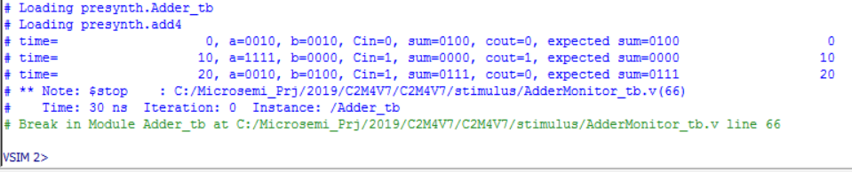
Adder Test Bench Output

Slide 56
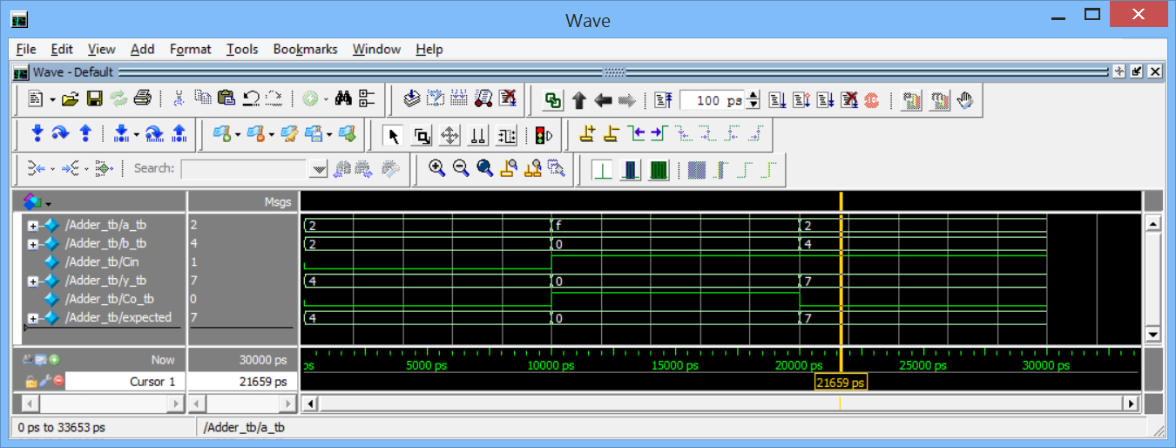
Adder Test Bench Output

Slide 57
Adder Test Bench with Loops
integer i, j, k;
//Adder Testbench, continued
//Test stimulus generation
initial
begin // loop over number of a inputs
// possible
for(i = 0; i<16; i = i+1) begin
a_tb <= i;
for(j=0; j<16; j = j+1) begin
b_tb <= j;
for (k=0; k<2; k=k+1) begin
Cin <= k;
#(10);
expected <= a_tb + b_tb + Cin;
end
end
end
end

Slide 58
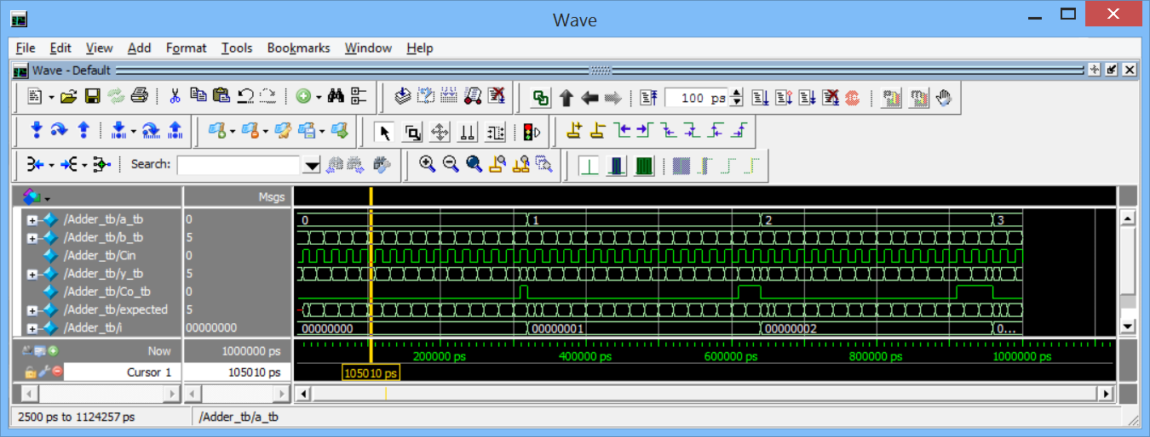
Adder Test Bench Output

Slide 59
Adder Test Bench with Self-checking
From the previous slide, Replace
expected <= a_tb + b_tb + Cin;
with
if (y_tb !== a_tb + b_tb + Cin)
begin
$display(“Error - sum is wrong”);
$stop
end

Slide 60
Adder Test Bench with Assertions
assert_label:
assert (y_tb == a_tb + b_tb + Cin)
begin
$display("Test passed");
end
else
begin
$error("Error - sum is wrong");
$stop;
end

Slide 61
Counter Test Bench
Counter Test Process
Data (D3..D0)
En
Load
Reset Generator
Reset
Counter DUT
Clock
Clock generator
Qexpected (D3..D0)
Q (D3..D0)
Compare

Slide 62
Counter Test Bench
timescale 1 ns / 1 ps // set timescale
// to nanoseconds, ps precision //Testbench entity declaration
module Counter_tb (); // top level, no external ports //constant declarations
parameter delay = 10; //ns defines the wait period.
localparam n = 4; // width of counter in bits
localparam T = 20; // clock period
// signal declarations
reg clock = 0; //clock if needed, from generator model
reg reset = 0; // reset if needed
reg [n-1:0] data_tb = 4'b0000; // data input stimulus
reg load = 0, en = 0; // input stimulus
wire [3:0] q; // output to check
reg [n-1:0] checkcount= 4'b0000;// variable to compare
// to count

Slide 63
Counter Test Bench
// Component Instances
// instantiate the device under test
Counter DUT ( // Device under Test
// Inputs
.d(data_tb),
.clk(clock),
.reset(reset),
.load(load),
.en(en),
// Outputs
.q(q)
);

Slide 64
Counter Test Bench
// External Device Simulation Processes
// clock driver
always
begin
clock = 1'b1;
#(T/2);
clock = 1'b0;
#(T/2);
end
// reset driver
initial
begin
reset = 1'b1;
#(T/2);
reset = 1'b0;
end

Slide 65
Counter Test Bench
// Test Process
initial // test generation process
begin
@(negedge reset) // wait for reset inactive
@(negedge clock) // wait for one clock
// Test load
load = 1'b1;
en = 1'b0;
data_tb = 4'b1010;
@(negedge clock) // wait for one clock
if (q != 4'b1010)
$display("Load failure %b", q);

Slide 66
Counter Test Bench
// Test Process, continued
// test count
checkcount = 4'b1010; // compare variable
load = 1'b0;
en = 1'b1;
repeat (2**n)
begin
checkcount = checkcount + 1; // count
@(negedge clock) // wait for one clock
if (q != checkcount)
$display("Count failure at time %g/t at
count %b", $time, q);
end
$stop; // end simulation
end
endmodule

Slide 67
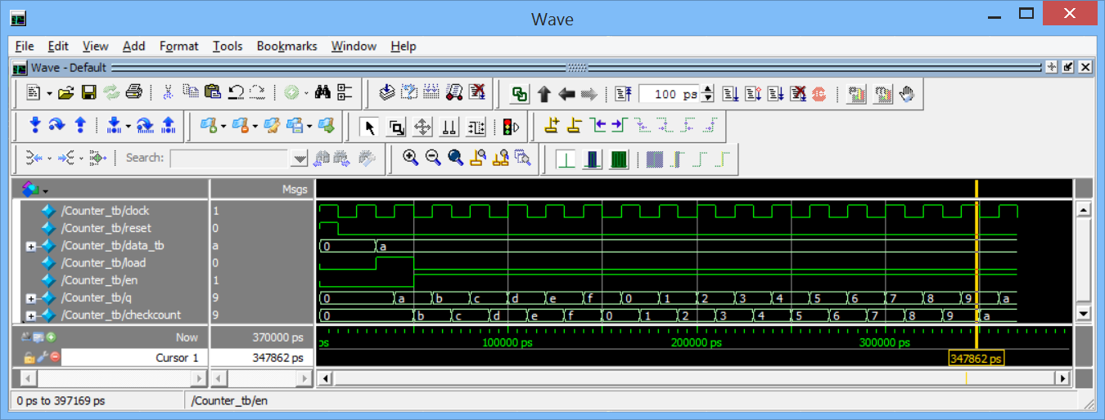
Counter Test Bench Output

Slide 68
Summary – Testbenches in Verilog II
In this video, you have learned:
How to write simple testbenches for synchronous circuits
How to use external signal generators to create stimulus for synchronous circuits.

Slide 69
References
[1] Pong P. Chu, “Regular Sequential Circuit” in Embedded SOPC Design with NIOS II Processor and Verilog Examples, Hoboken, NJ, Wiley, 2012, ch. 5, sec. 5.2, pp. 107-110
[2] D. Smith, “Test Harnesses” in HDL Chip Design, A practical guide for designing, synthesizing and simulating ASICs and FPGAs using VHDL or Verilog, Madison, AL, Doone Publications, 1996, ch. 11, pp. 323-344.

Slide 70
Making Memories
Memories are a common element in most digital systems. Earlier in this course we described a register file circuit, in which individual registers were enabled for access by decoding an address. We will now extend this to include RAM and ROM memories.

Slide 71
Synchronous Logic: Register File
Register Files are useful constructs that allow addressing of registers. Here we assume each flip flop represents an n-bit register.
wdata
D
Q
En
D
Q
rdata
wAddress
En
Decoder
D
Q
wren
En
Clk
D
Q
En
rAddress

Slide 72
Dual Port RAM
module DPRAM
#(
parameter Data_width = 8, //# of bits in word
Addr_width = 10 // # of address bits
)
( //ports
input wire clk,
input wire we,
input wire [(Addr_width-1):0] w_addr, r_addr,
input wire [(Data_width-1):0] d,
output wire [(Data_width-1):0] q
);

Slide 73
Dual Port RAM
// signal declarations
reg [Data_width-1:0] ram [2**Addr_width-1:0];
// 2 dimensional array for RAM storage
reg [Data_width-1:0] data_reg;
// read output reg.
// RAM initialization from an external file
initial
$readmemh(“initalRAM.txt”, ram);

Slide 74
Dual Port RAM
// body
// write operation
always @(posedge clk)
begin
if (we)
ram[w_addr] <= d; // write data
data_reg <= ram[r_addr]; // read data to reg
end
// read operation
assign q = data_reg;
endmodule

Slide 75
ROM memory
module ROM
#(
parameter Data_width = 8, //# of bits in word
Addr_width = 3 // # of address bits
)
( //ports
input wire clk,
input wire [Addr_width-1:0] addr,
output wire [Data_width-1:0] data
);
// signal declarations
reg [Data_width-1:0] rom_data, data_reg;

Slide 76
ROM Memory
// body
always @(posedge clk) // output register
data_reg <= rom_data;
always @*
case(addr) // lookup table
3’b000: rom_data = 8’b1000_0000;
3’b001: rom_data = 8’b1010_1010;
3’b010: rom_data = 8’b0101_0101;
3’b011: rom_data = 8’b1000_0011;
3’b100: rom_data = 8’b0000_0000;
3’b101: rom_data = 8’b1001_1001;
3’b110: rom_data = 8’b1000_0001;
3’b111: rom_data = 8’b1111_0000;
endcase
assign data = data_reg;
endmodule

Slide 77
Finite State Machines
Finite State Machines (FSM) are a very important part of digital design (and software design, too!).
The state machine concept provides a highly reliable, maintainable, and methodical way to design circuits that perform a sequence of operations with great predictability. State machines are always in a known state. Good Designers all use FSMs.

Slide 78
General FSM Block Diagram
FSMs are broadly categorized into 2 types: Moore or Mealy.
In Moore machines the output only depends on the state.
In Mealy machines the inputs and the state drive the output.
Output Logic
(combinational)
Mealy
Outputs
Inputs
Next State Logic
(combinational)
Current State Register
(sequential)
Output Logic
(combinational)
Moore
Outputs
Clock
Reset

Slide 79
Example of FSM
State Diagram and State Table
Current State | Next State | Next State | Next State | Output | Output
 | Input = MoveCW | Input = MoveCCW | Input = NoMove | DesiredPosition | PosError
An0 | An45 | An315 | An0 | Current State | Dpos - PhyPos
An45 | An90 | An0 | An45 | .. | ..
An90 | An135 | An45 | An90 | .. | ..
An135 | An180 | An90 | An135 | .. | ..
An180 | An225 | An135 | An180 | .. | ..
An225 | An270 | An180 | An225 | .. | ..
An270 | An315 | An225 | An270 | .. | ..
An315 | An0 | An270 | An315 | .. | ..
An0
An315
An45
NoMove
An270
An90
MoveCCW
An225
An135
An180
MoveCW

Slide 80
State Encoding
No. | Binary | Gray | Johnson | One-Hot
0 | 000 | 000 | 0000 | 00000001
1 | 001 | 001 | 0001 | 00000010
2 | 010 | 011 | 0011 | 00000100
3 | 011 | 010 | 0111 | 00001000
4 | 100 | 110 | 1111 | 00010000
5 | 101 | 111 | 1110 | 00100000
6 | 110 | 101 | 1100 | 01000000
7 | 111 | 100 | 1000 | 10000000

Slide 81
Implementation with Binary Encoding
module AngleFSM
#( // Binary encoding of states
parameter State_width = 3,
An0 = 3'b000,
An45 = 3'b001,
An90 = 3'b010,
An135 = 3'b011,
An180 = 3'b100,
An225 = 3'b101,
An270 = 3'b110,
An315 = 3'b111)
( //ports
input wire clk, reset, MoveCW, MoveCCW,
input wire [(State_width-1):0] PhysicalPosition,
output wire [(State_width-1):0] DesiredPosition, PosError
);
reg [(State_width-1):0] CurrentState, NextState;

Slide 82
Implementation with Binary Encoding
An45:
if (MoveCW ==1)
NextState = An90;
else if (MoveCCW == 1)
NextState = An0;
else
NextState = An45;
... //states An90 to An270 here
An315:
if (MoveCW ==1)
NextState = An0;
else if (MoveCCW == 1)
NextState = An270;
else
NextState = An315;
default:
NextState = PhysicalPosition;
endcase
end
// body of FSM is case statement
// Next State Logic
always @(MoveCW or MoveCCW or PhysicalPosition or CurrentState)
begin: Combinational
case (CurrentState)
An0:
if (MoveCW ==1)
NextState = An45;
else if (MoveCCW == 1)
NextState = An315;
else
NextState = An0;

Slide 83
Implementation with Binary Encoding
// Current State Register
always @(posedge clk or negedge reset)
begin: Sequential
if (!reset)
CurrentState = PhysicalPosition;
else
CurrentState = NextState;
end
// Output Logic
// Moore Outputs
assign DesiredPosition = CurrentState;
// Mealy Outputs
assign PosError = DesiredPosition - PhysicalPosition;
endmodule

Slide 84
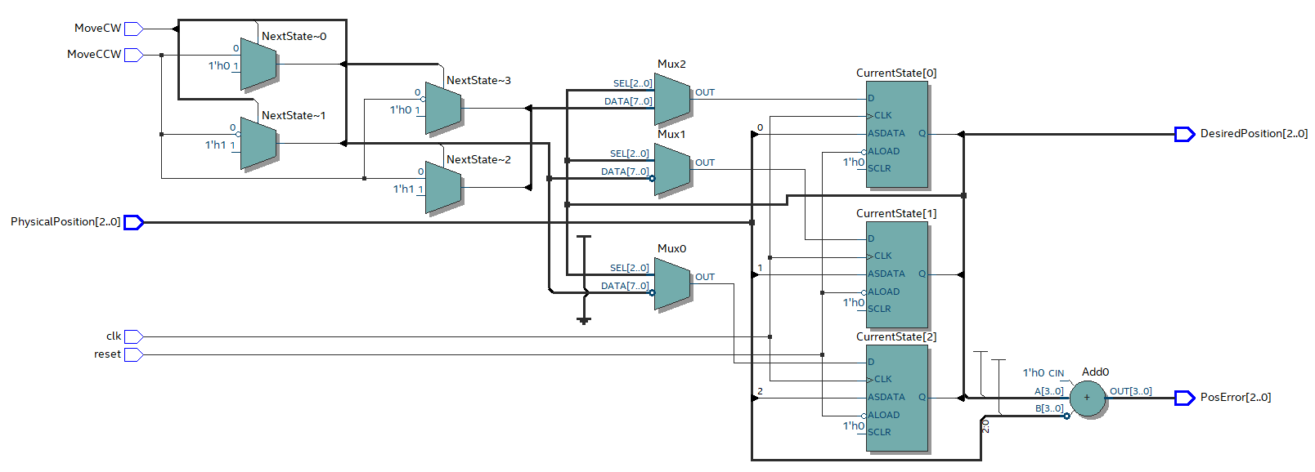
Implementation with Binary Encoding
Schematic

Slide 85
State Encoding Comparison
Encoding | Registers (FFs) | Total Logic Cells FSM | Output Encoding Conversion Logic | Total Logic Cells
Binary | 3 | 17 | 0 | 17
Gray | 3 | 20 | 9 | 29
Johnson | 4 | 36 | 9 | 51
One-Hot | 8 | 107 | 33 | 146

Slide 86
Summary – State Machines in Verilog
In this video, you have learned:
The rationale for use of Finite State Machines
How to create Finite State Machines using Verilog
Criteria for determining which state encoding formats to use

Slide 87
References
[1] D. Smith, “Modeling Finite State Machines” in HDL Chip Design, A practical guide for designing, synthesizing and simulating ASICs and FPGAs using VHDL or Verilog, Madison, AL, Doone Publications, 1996, ch. 8, pp. 195-201.

